Slide 1
DTI prediction with KiBA dataset
Sean Wang
Data Scientist

Slide 2
Data Challenge
Design a machine learning approach to predict binding between protein/molecule pairs based on Kinase Inhibitor BioActivity (KIBA) Dataset
1. A list of UniProt IDs & PubChem IDs has been provided for pairs with confirmed binding affinity.
2. You may only use these proteins and chemicals in designing your model (though you can create permutations of the pairs to generate synthetic negative examples).
3. The kiba_score_estimated column will be True if a KIBA score in that row is estimated, or False if directly calculated using the standard Kd, Ki, and IC50 scores.
4. Leverage the provided data or collect any additional outside data relating to the provided proteins & chemicals as that may be needed to improve your model’s performance, if applicable.
5. Your model will be evaluated on a held-out test set; please provide any reproducible code that we can use to pull additional outside data for our test set.
6. You are welcome to use any open-source libraries/packages/resources but keep in mind to include the details of what is going on ‘under the hood’ in your summary and analysis.
7. For any auxiliary datasets as part of your solution, if applicable, please provide references and relevant python code/functions so that we can pull in the same data for review

Slide 3
Reference
Affinity2Vec (https://www.nature.com/articles/s41598-022-08787-9#Sec2), with git repo at https://github.com/MahaThafar/Affinity2Vec
GANsDTA: Predicting Drug-Target Binding Affinity Using GANs
GraphDTA: Predicting drug-target binding affinity with graph neural networks (https://github.com/thinng/GraphDTA)

Slide 4
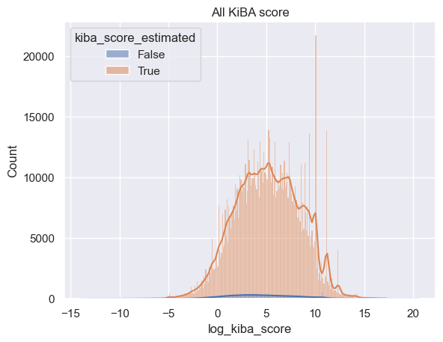
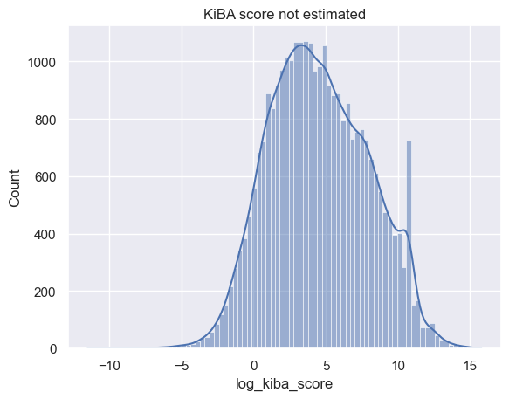
KiBA score (log) distribution
T-test shows that kiba scores that are estimated are significan’t different from those that are not estimated (from experiment?), meaning?
There several peaks of binding affinity score at high end, is it due to the detection limitation of the bioassay or prdiction method? Are those of low quality?
Should score > 15 be treated as inactive or just removed from analysis?

Slide 5
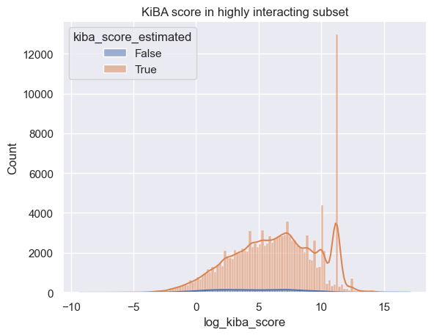
Plan on using two subsets
Two subsets:
Set1 (Kiba score not estimated): 1370 protein and 21805 compounds with 29711 interactions (high quality?)
Set2: Multi-interactions 139516 pairs: 17228 compound with >= 5 interactions and 1232 proteins with >= 10 interactions
Cross-validation between those 2 data sets, train on one and test on another, comparing performance
Option: Removal of kida score peak at 11.18 as those seems to add a lot of noise

Slide 6
Workflow
Download protein sequence and compound smile string from Uniprot (“Bio.ExPASy”) and Pubchem (“pubchempy”), optionally with other information.
Convert protein sequence to embeddings (esm2_t12_35M_UR50D, size 480, with “protenc”)
Convert smile sting to embeddings (RDKitFingerprint, size 128, with “scikit_mol” and “rdkit”)
Join protein embeddings with compound embeddings based on pairing (608 total features)
Regression model against target variable log KiBA score.

Slide 7
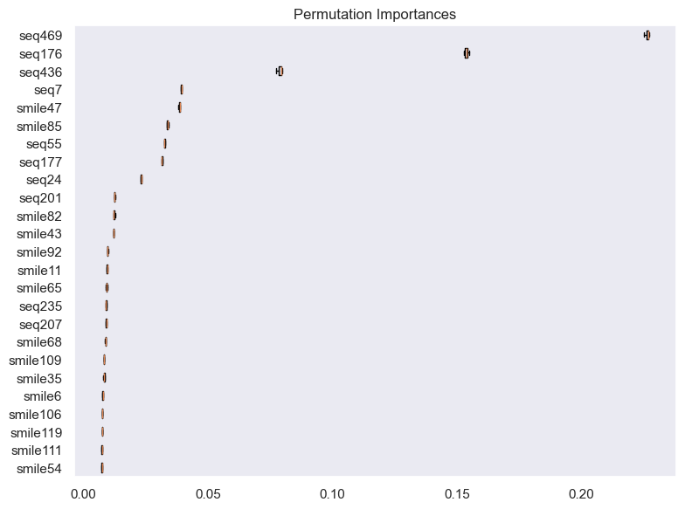
RandomForest and XGBoost Regression Model
Increasing number of tree and depth of tree reduced overall error, however the gap between training and testing became larger, indicating over-fitting
XGBoost model shows more overfitting, need more tuning
Feature importance (RF) show top 4 are sequence features.
Removing the cluster of data points at KiBA score 72000 improve performance more on testing than training (MSE 4.78 vs 5.7, RF)
Normalization didn’t help
 | Random Forest |  | XGBoost
 | Train | Test | Train | Test
mean absolute error | 1.696 | 1.945 | 0.41 | 1.626
median absolute error | 1.349 | 1.603 | 0.01 | 1.15
mean squared error | 4.862 | 6.241 | 0.997 | 5.174
max error: | 12.928 | 12.779 | 10.589 | 14.297
r2 score: | 0.581 | 0.464 | 0.914 | 0.556
Notes:
with 1000 tree and tree depth at 21, median absolute error training is 0.947, testing is 1.382

Slide 8
Improvement
Data side
Removal of entries with low quality KiBA score
Add other features:
protein function description, gene ontology, etc
compound physical-chemical properties
use different embedding size
Extract features from graph/network based on sequence similarity and compound similarity, with binding affinity score to connect compounds with proteins.
Model side
Model tuning, reduce overfitting
Feature selection
Use deep learning
Use GANs

Slide 9
Thoughts
Technical challenge
Tried to install several protein embedding packages: bio_embeddings, protvec, SeqVec, ProtEnc. Only ProtEnc can be installed in python 3.10.
ProtEnc comes with several pre-build models, running large model ended up with memory errors. It failed one of the two dataset with smaller number of sequences.

